Slide 1
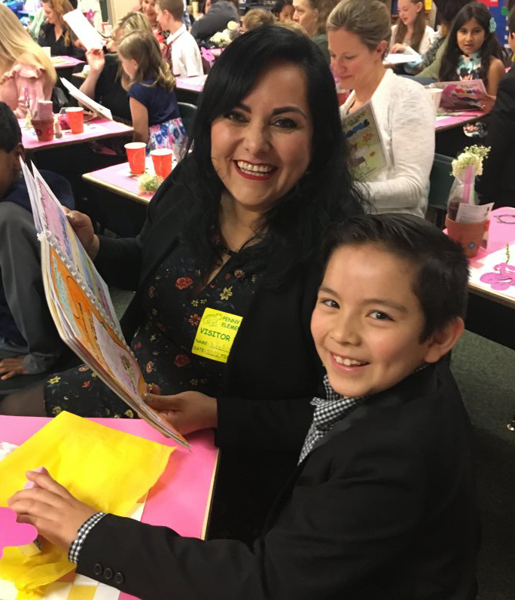
Welcome to Everett Public Schools

Slide 2

How many of these facts do you know?

Slide 3

95.7% of students graduate on time!

Slide 4

Everett Public Schools has one of the highest graduation rates in the state.

Slide 5

2,308 high school students took Advanced Placement classes in 2018-19.

Slide 6

We have
an app!
Search for Everett Public Schools in your app store.

Slide 7

Over 90 languages are spoken by students in Everett Public Schools.

Slide 8
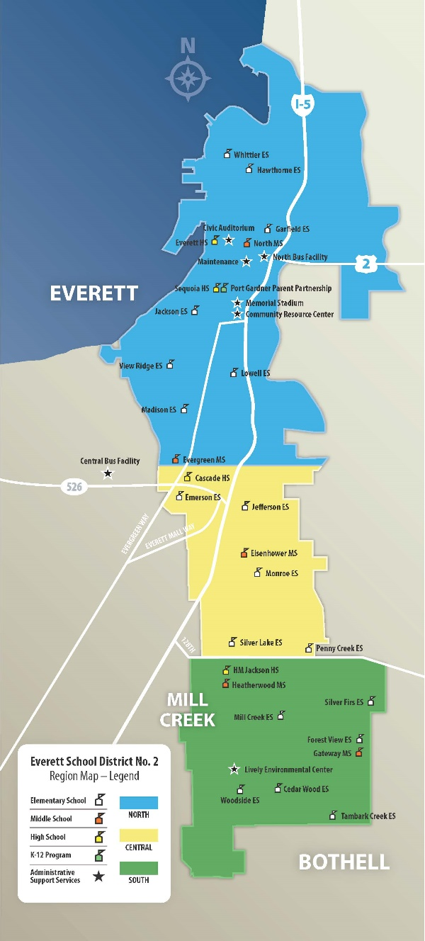
We are one of the fastest growing districts in the county.
Around 20,000 students now, 1,858 more expected by 2026.

Slide 9
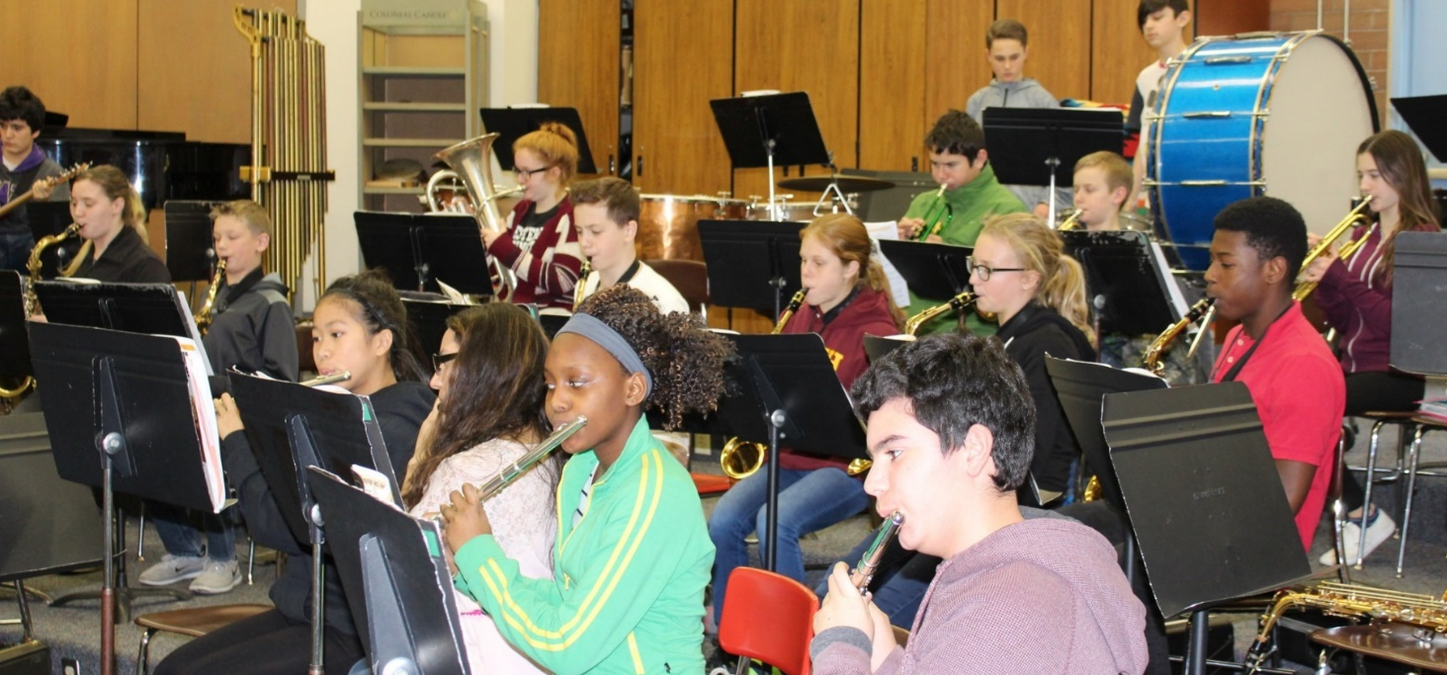
We partner with Music4Life to put gently-used music instruments into the hands of students in district music programs.

Slide 10
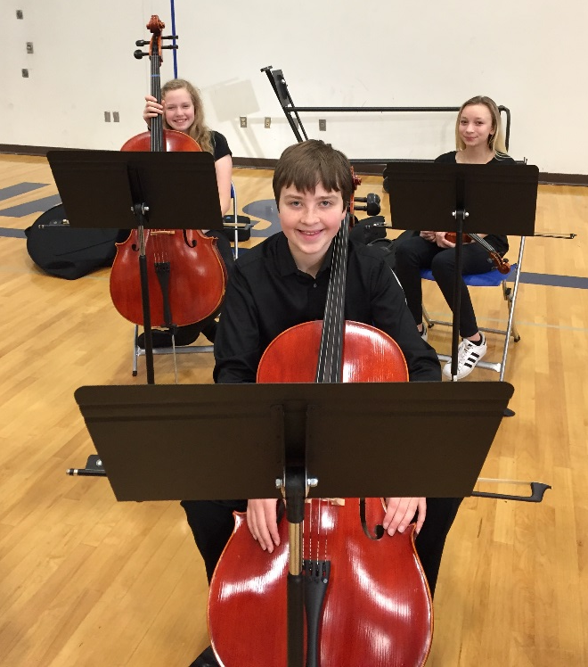
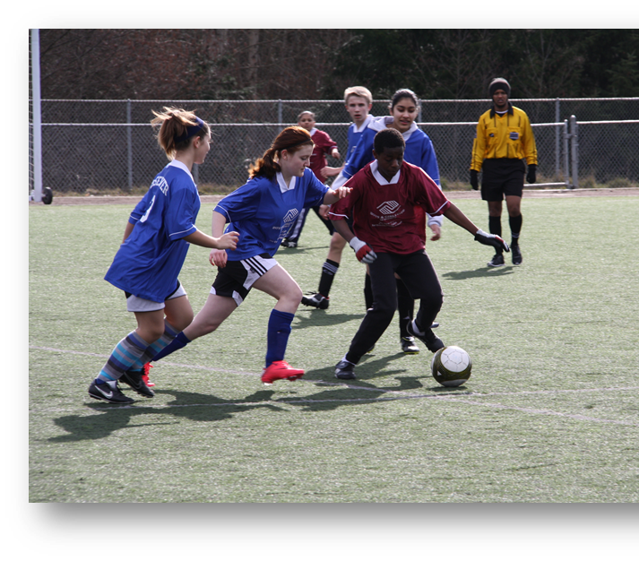
Students’ interests are supported
Orchestra
Performing arts
STEM
Athletics
Activities
One-to-one technology

Slide 11
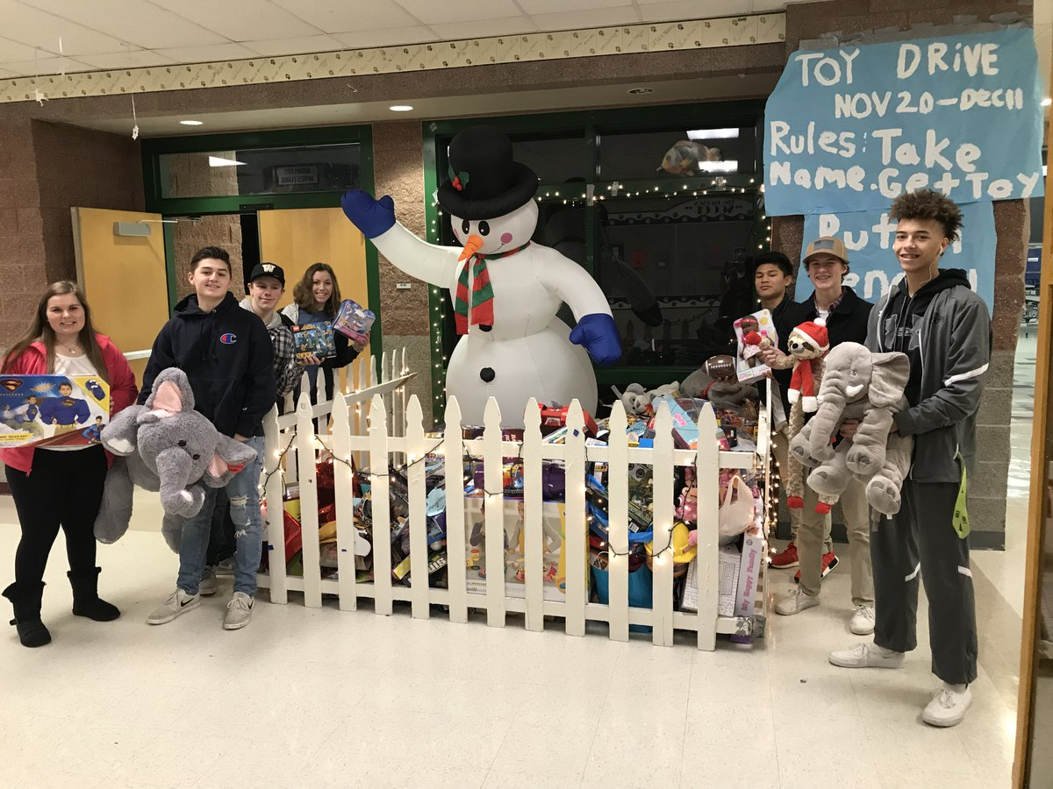
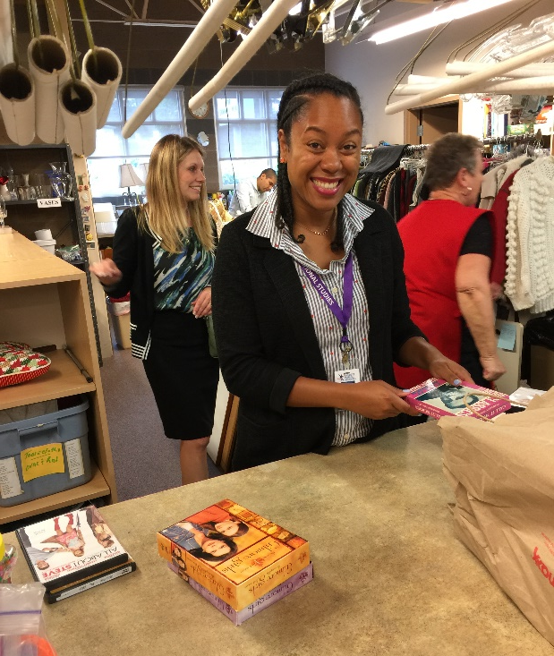
Community service is important to staff and students

Slide 12
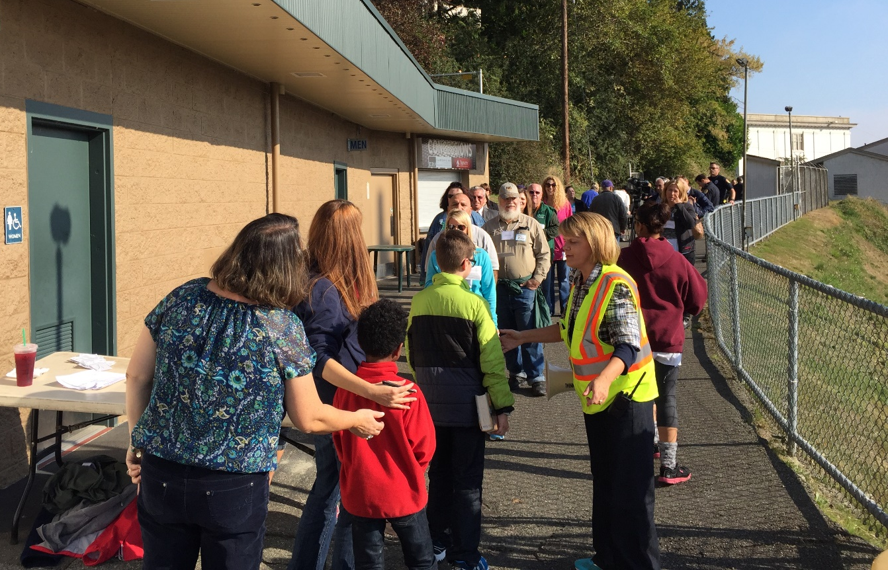
We focus on physical safety

Slide 13
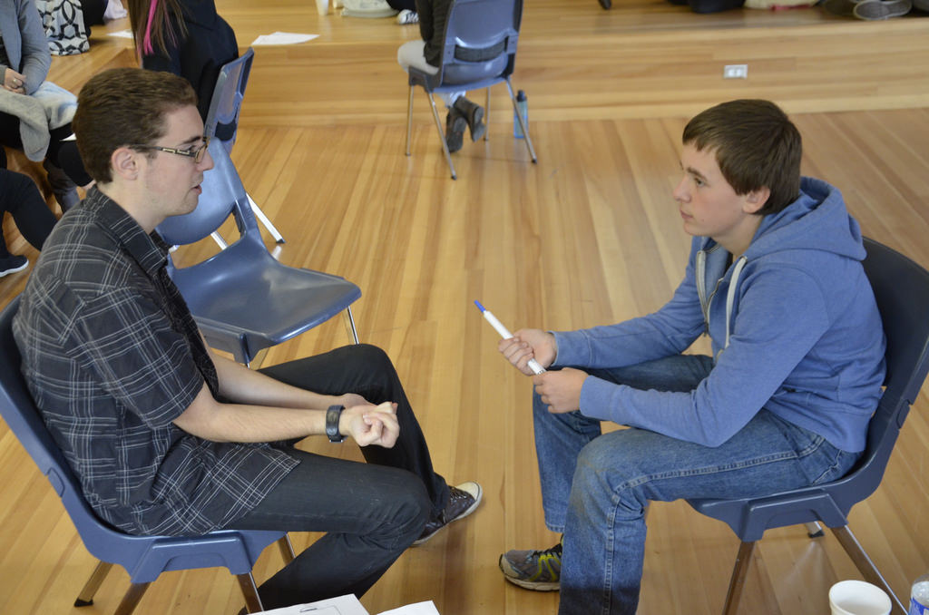
Emotional safety is a high priority

Slide 14
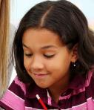
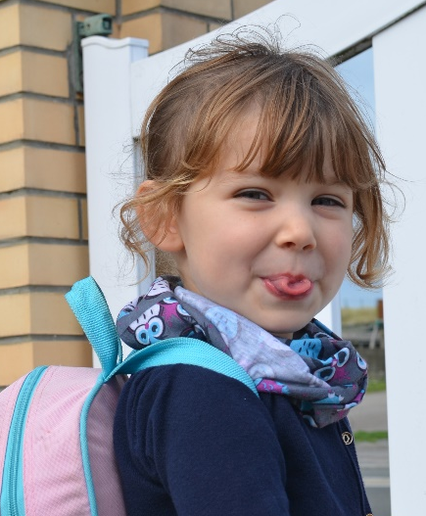

Over 1/3 of EPS students live in poverty
We served 1,666 homeless students last year –
enough to fill 3 elementary schools

Slide 15
District residents aged 60+ are eligible for free admission to some school sporting and performance events.
Call 425-385-4041 or see our website about the Senior PEP Club.

Slide 16
Assessment scores surpass the state … again!
Difference between percentage of district students meeting standard and the state percentages.
2019 | ELA | Math | Science
Grade 3 | +12.3 | +11.4
Grade 4 | +14.4 | +15.3
Grade 5 | +12.3 | +13.2 | +12.1
Grade 6 | +14.1 | +9.8
Grade 7 | +11.0 | +5.5
Grade 8 | +15.9 | +10.3 | +13.3
Grade 10 | +6.3 | +1.8
Grade 11 |  |  | +2.8

Slide 17
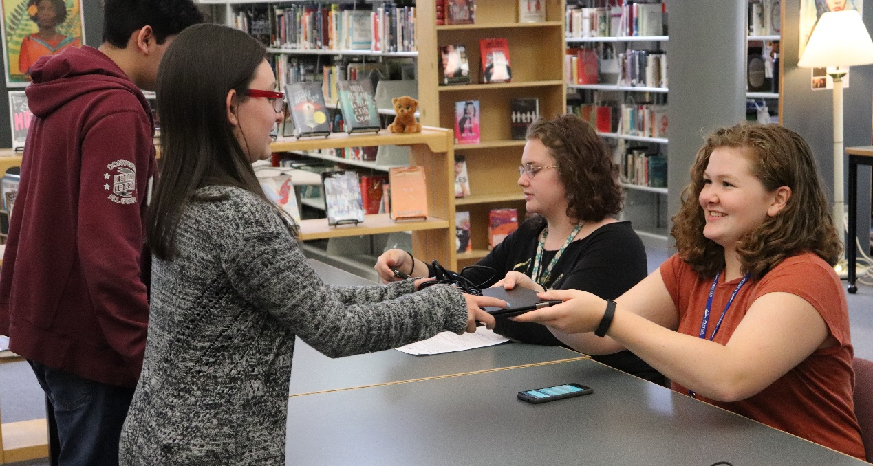
1:1 technology for students continues to roll out

Slide 18
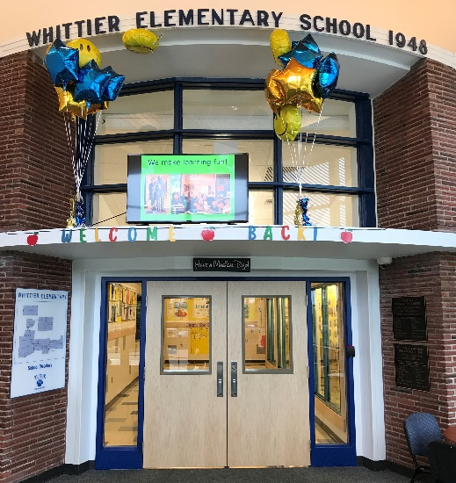
Thanks to the 2016 Bond support, the following safety projects were completed:
New security fencing
Interior vestibules
New security doors

Slide 19
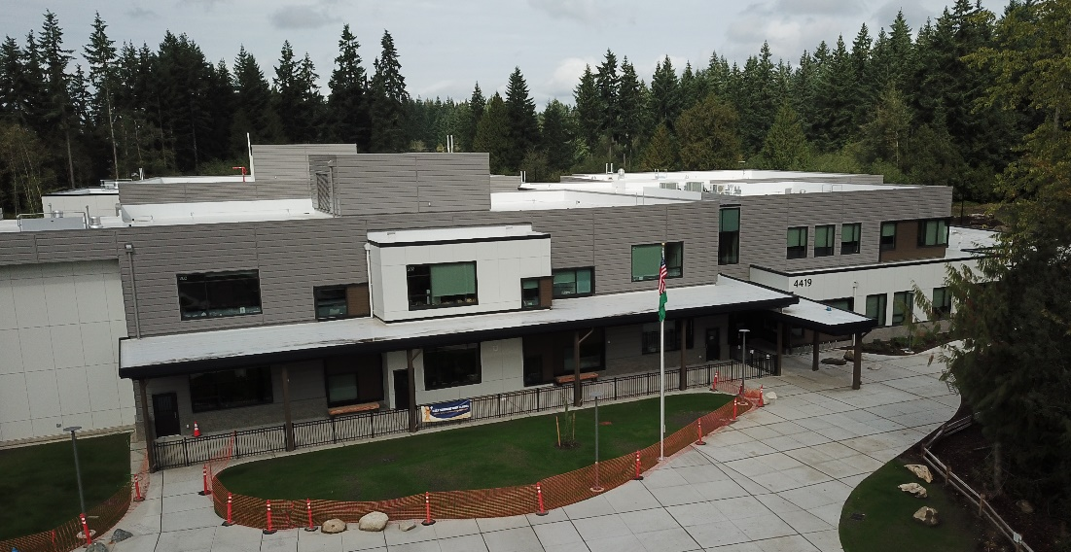
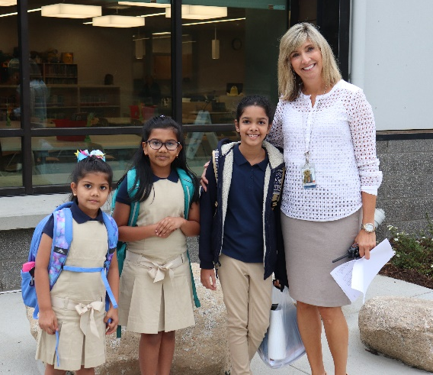
Tambark Creek Elementary opened this fall

Slide 20
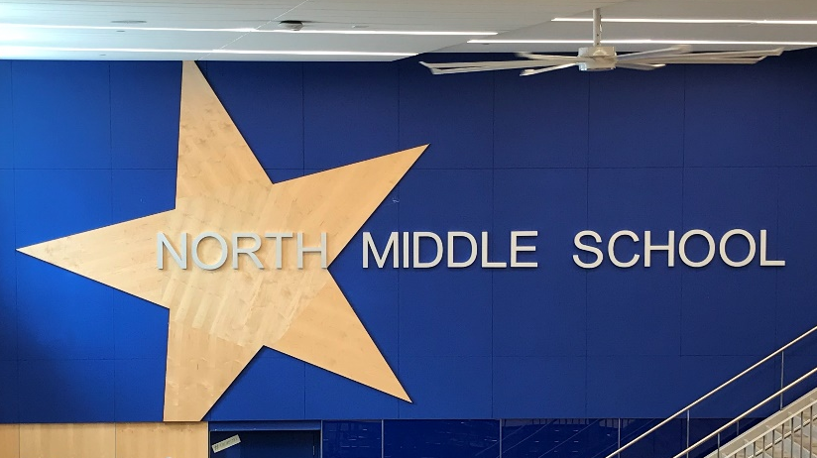
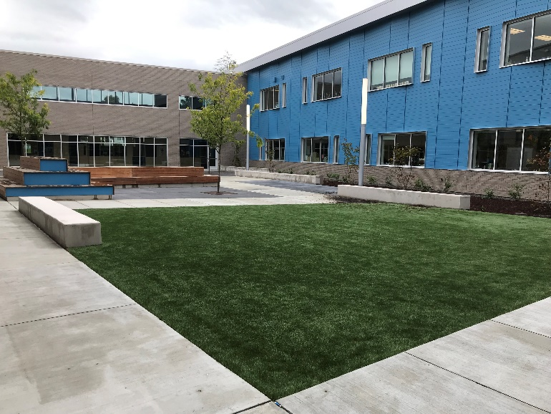
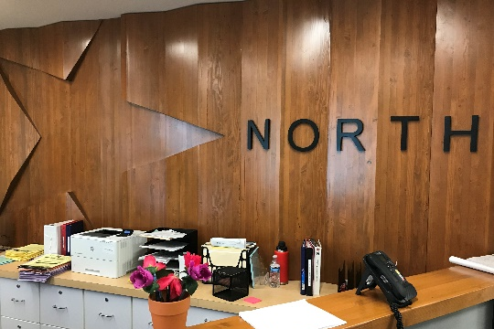
North Middle School modernization – opened this fall to students

Slide 21
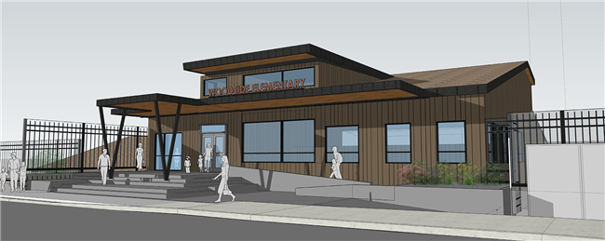
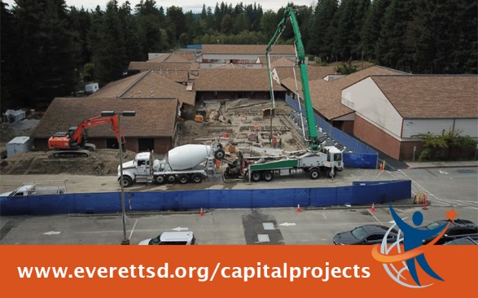
Woodside Elementary modernization project underway

Slide 22
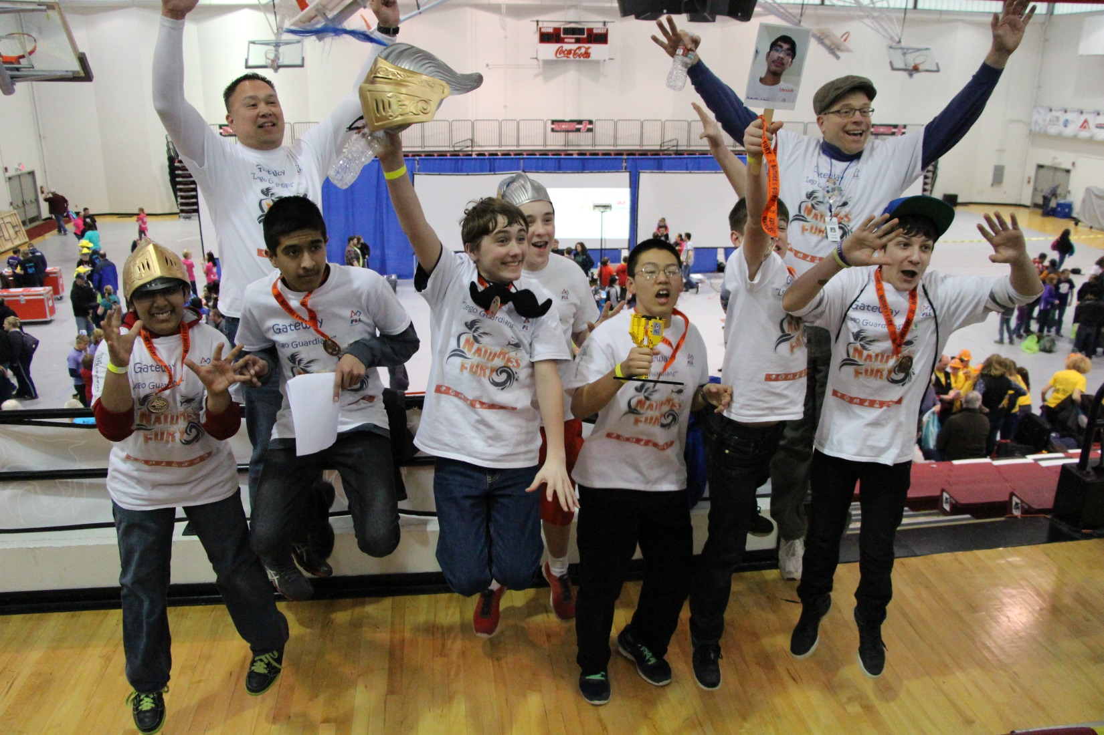
Each school has a robotics program.

Slide 23
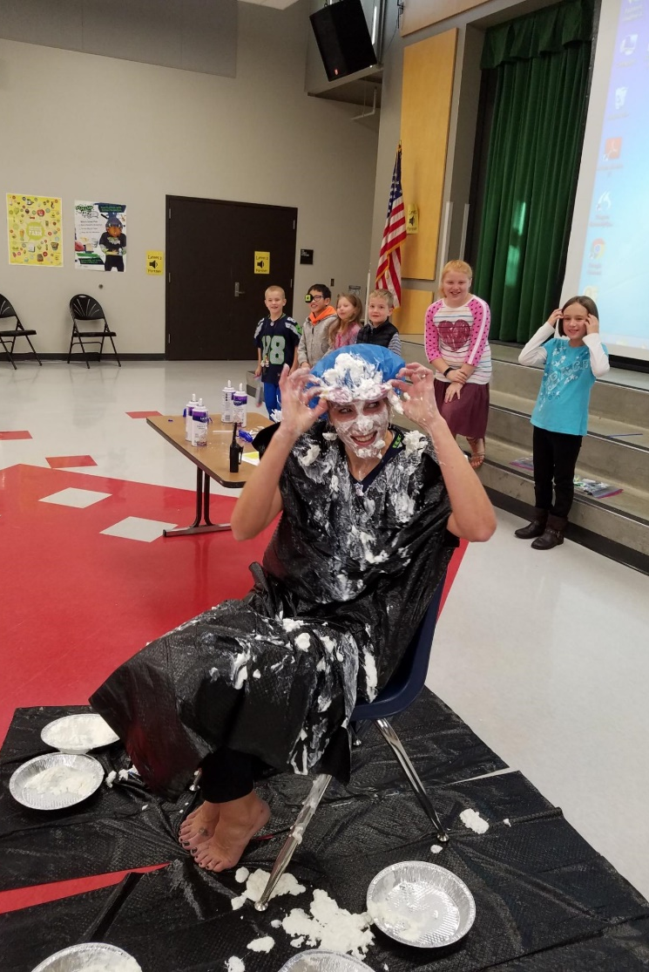
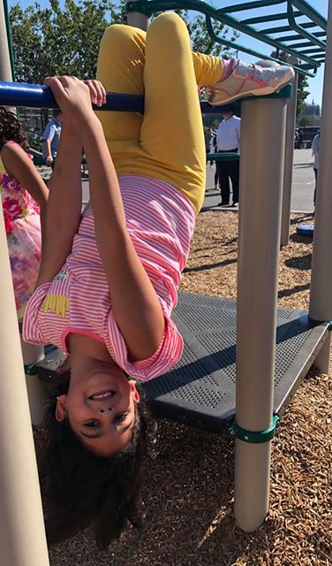
We laugh together … a lot!

Slide 24
Insert a fact about your school
Insert answer here

